Slide 1

Building an International Startup
Lefteris Ntouanoglou
CEO & Co-founder
redbookconnect.com

Slide 2
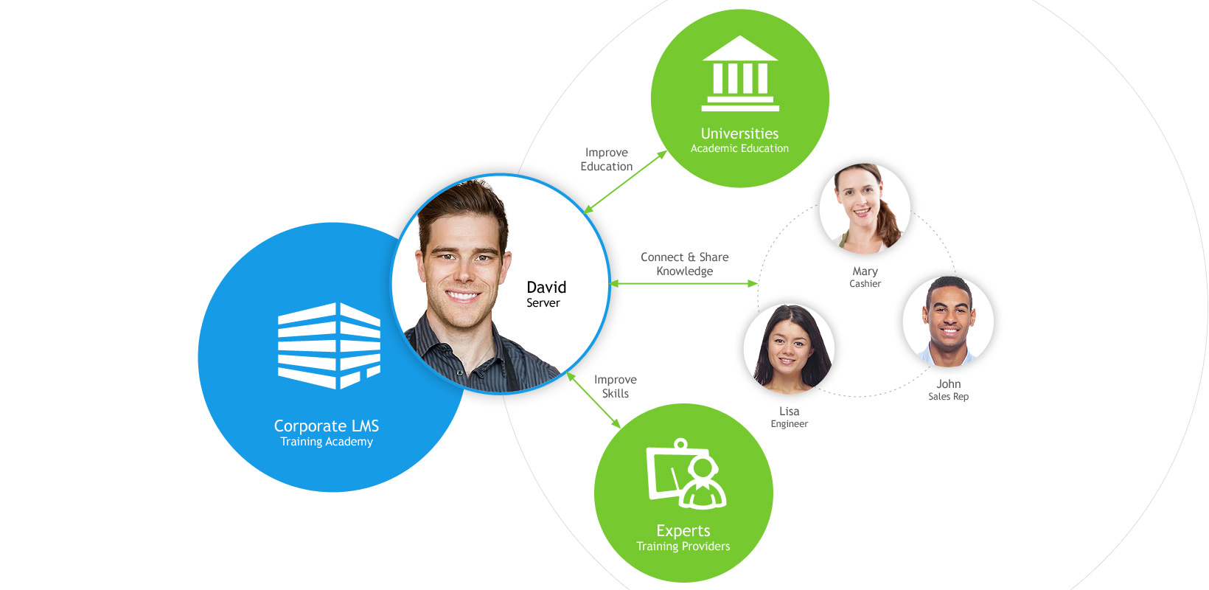
Our Idea: Reinventing Corporate Training
Strategic Positioning

Slide 3
Our story
The Challenge
1 out of 2,000 US based startup
companies raise money and 1 of 10
who raise money succeed.

Slide 4
Our story
06/2011
Beta Launch of Schoox
5,000 users

Slide 5
Our story
07/2011
First trip to the US
Silicon Valley - Austin

Slide 6
Our story
12/2012
First Million $ raised
Series A1

Slide 7
Our story
06/2013
First customer in the US
1 Restaurant with 3 locations

Slide 8
Our story
11/2013
An inconceivable Challenge
Milford – New York

Slide 9
Our story
12/2014
The Opportunity

Slide 10
Our story
08/2015
A huge Success

Slide 11
Our story
06/2018
5M+ users
120 countries, 1,000+ brands

Slide 12
Our only advice
Go Big or Don’t Go

Slide 13
Thank You!
redbookconnect.com

