Slide 1
Exportgate.gr
Digital Ecosystems for Business Beyond Borders
Jun 2018
Confidential

Slide 2

All major export associations united under one extroversion umbrella
Exportgate is an initiative of Eurobank, implemented in collaboration with the three export organizations of Greece, the Greek International Business Association (SEVE), the Panhellenic Exporters Association (PSE), the Exporters Association of Crete (EAC), with the support of the Hellenic Federation of Enterprises (SEV)

Slide 3




Exportgate.gr on a continuous success path since its launch in 2013
1.2 mil
visitors from 110 countries
3,000
Greek companies
+180
countries with digital libraries on customs, etc.
1st Intl Recognition
IBM proposed Exportgate.gr as one of the most innovative projects in International Trade
GOLD EFFIE AWARD
Exportgate is the proud award winner of Gold Effie 2014
Global Innovation Award
Eurobank and Exportgate are awarded with the Global Finance Innovators 2015 distinction
Market Excellence Award 2017
Communicating Effectively B2B Marketing Communications for Go International – Go in Crete

Slide 4
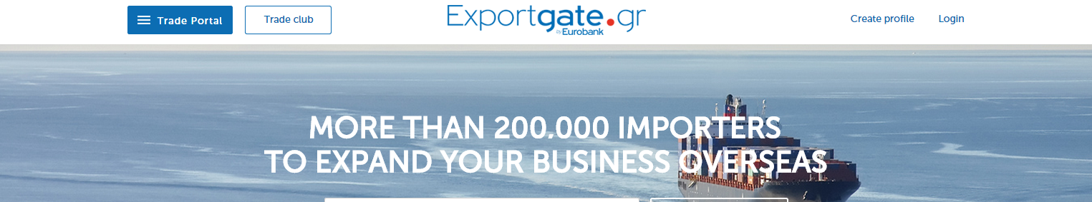
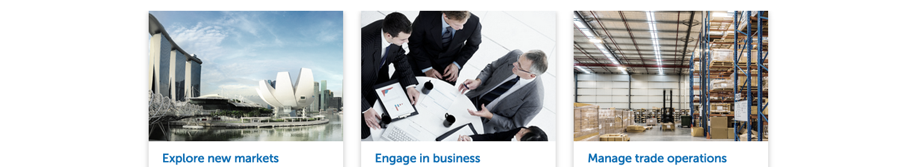
Exportgate at a glance
Library
Providing market entry resources for Greek companies with a rich library of 25.000 market reports and
Club
An innovative business network platform exclusively dedicated to our Greek and Cypriot clients
Resources
Documents, controls, Customs, tariffs for over 180 countries worldwide along with digital customs barriers

Slide 5


Banks form the 1st Global Business Ecosystem - The Trade Club Alliance

Slide 6
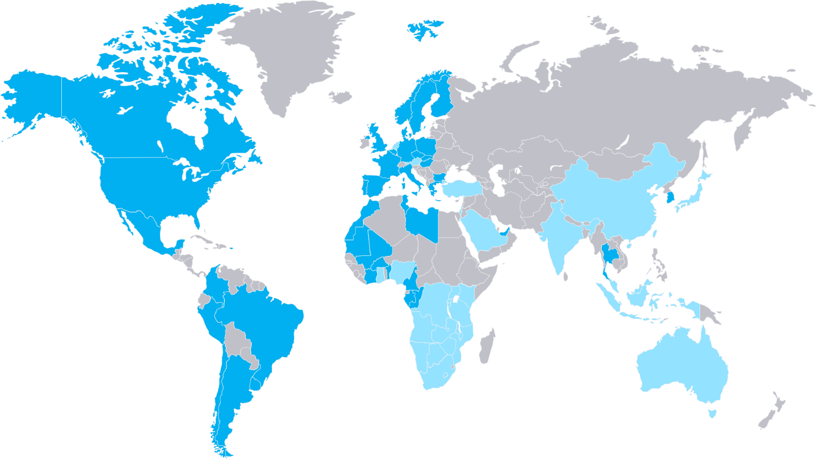

The “Trade Club Alliance” overview
Trade Club Alliance interconnects +12.000 international trade oriented clients
Expected to grow to 100.000 in 3 years, to cover more than 50 countries

Slide 7
Member companies and Sectors distribution
+50% of member companies belong to SME/SB segments
All trade-able goods sectors are represented
9%
25%
24%
2%
29%

Slide 8
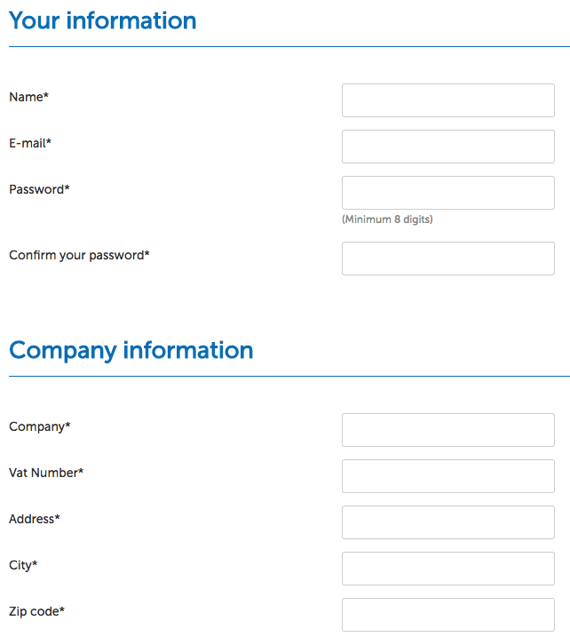
Entering the Club - 3 simple steps for Greek & Cypriot Companies
1. Register in Exportgate.gr
2. Receive Trade Club invitation
3. Complete Trade Club Business Card

Slide 9
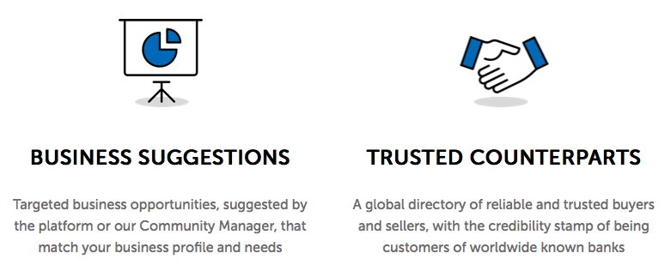
Innovative tools to Greek & Cypriot Businesses
Receive Match-Making suggestions
Search for counterparts in all countries of Trade Alliance

Slide 10
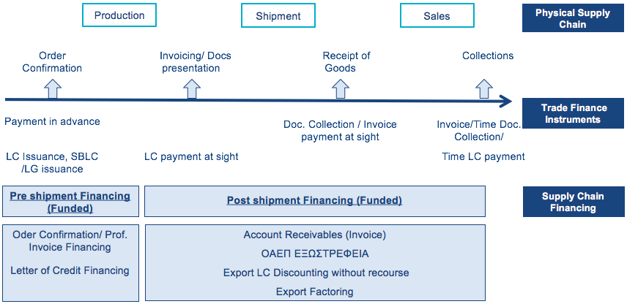
The ETC :: Specialized Banking tools for Greek Trade Club Members
ETC limit & Eurobank services simplify complex Trade Finance processes
A specialized, concrete set of Trade Finance tools and a dedicated team of Trade Experts are available to Trade Club members, in order to enhance international business

Slide 11

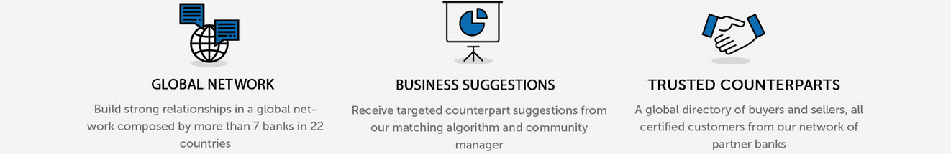

Thank you!
Log-in today and start exploring a digital world of trade partnerships

