Slide 1
AEOLIX- European data exchange network in Logistics
Dr. Georgia Ayfantopoulou, Deputy Director-Research Director
CERTH / HIT

Slide 2
Table of Contents
Challenges
Logistics & Supply Chain needs
The AEOLIX network
Get engaged
Notes:
Freight and logistics is a domain that benefits from an interconnected world and the ERTICO partnership is working towards the goal of interconnectivity in Transport &Logistics.
Yet why is there still fragmentation within the supply chain industry?

Slide 3
Global policy changes- emissions
Logistics actors have started to implement environmentally friendly collaborative strategies addressing supply chain
The existence of different standards, initiatives each with own methodology and calculation tools for carbon footprint of transport is hampering the comparison and analysis of results
Logistics companies still need to track, document and disclose their CO2 emissions as customers now want to know more about the supply chain provenance of the products they buy.
Notes:
Firstly, forced to meet such as emissions, but the existence of different standards, initiatives each with own methodology and calculation tools for carbon footprint of transport is hampering the comparison and analysis of results. This makes it essential for companies to disclose information on the ethical origin of goods and on the environmental impact of production and distribution.

Slide 4
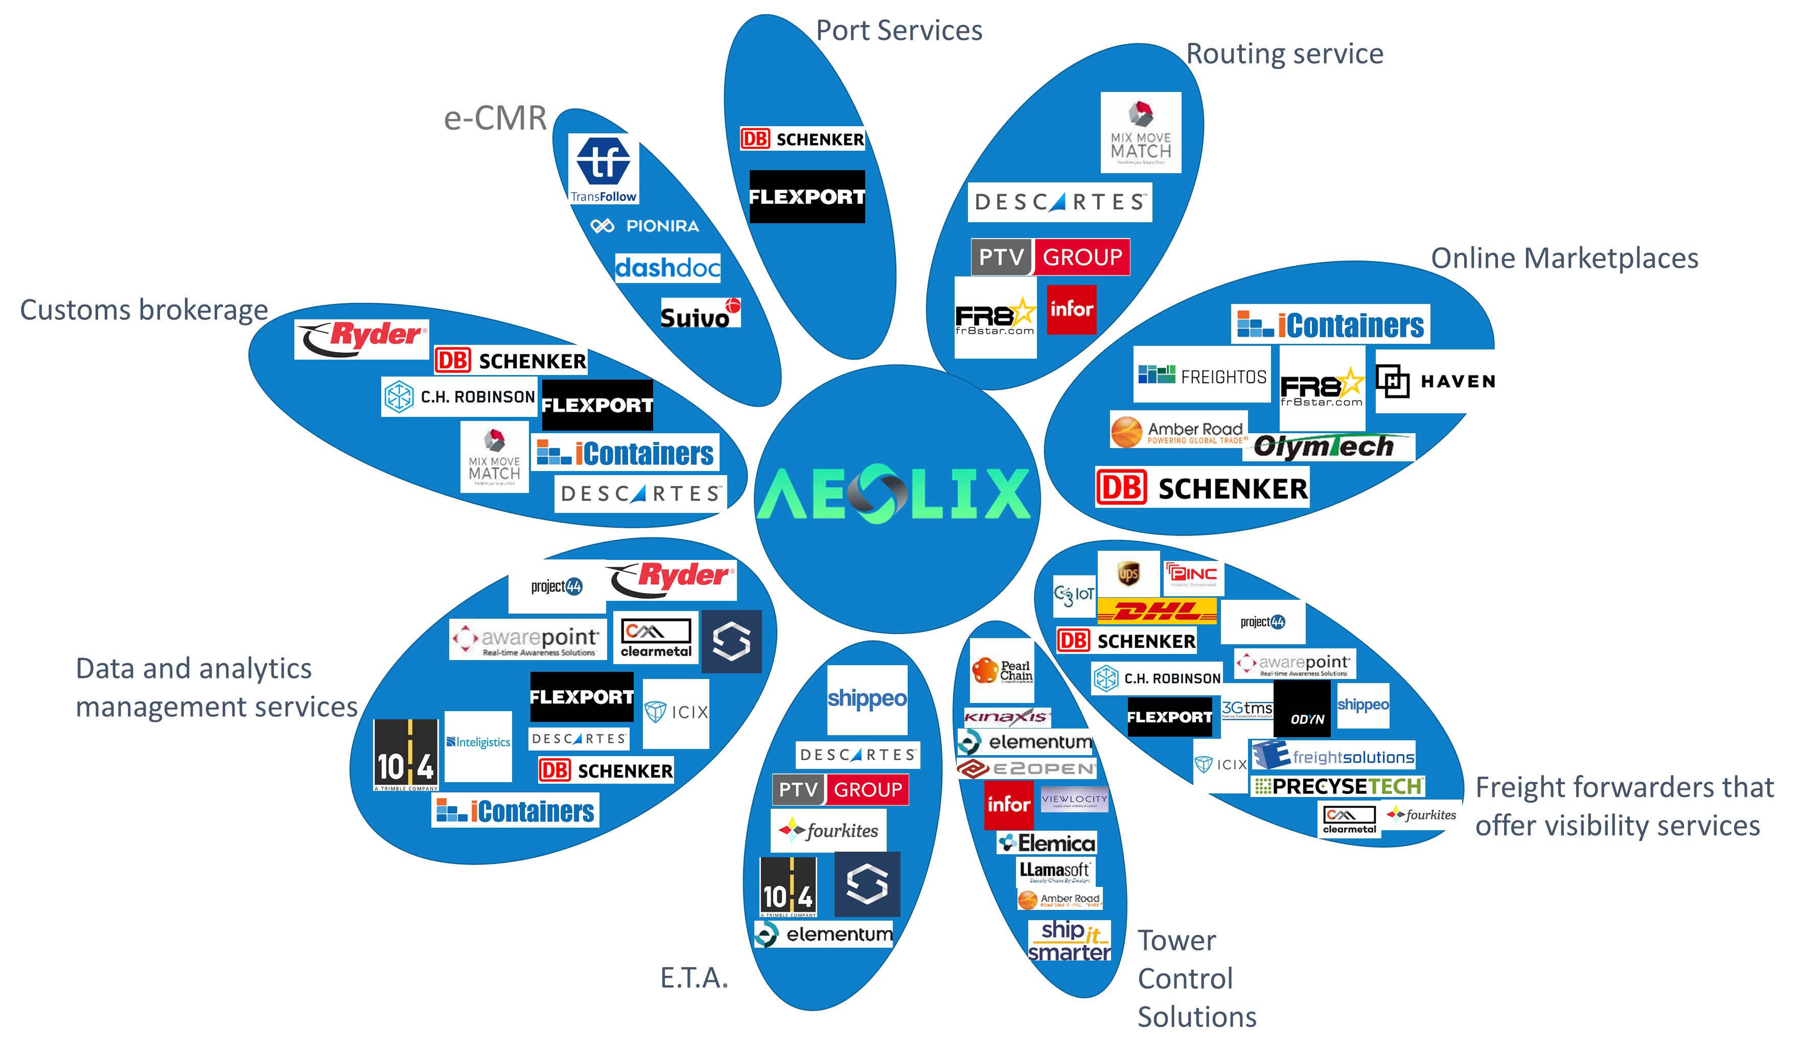
An industry in transformation: Consolidation
Notes:
Well most of the logistics actors already have an IT control tower or an ERP, Transport Management System but what they miss is a complete sharing of information across the supply chain. Information gaps remain due to the disparate and passive nature of data. Each logistics player is currently required to log into each system separately to look for information or manually insert data into different formats.

Slide 5
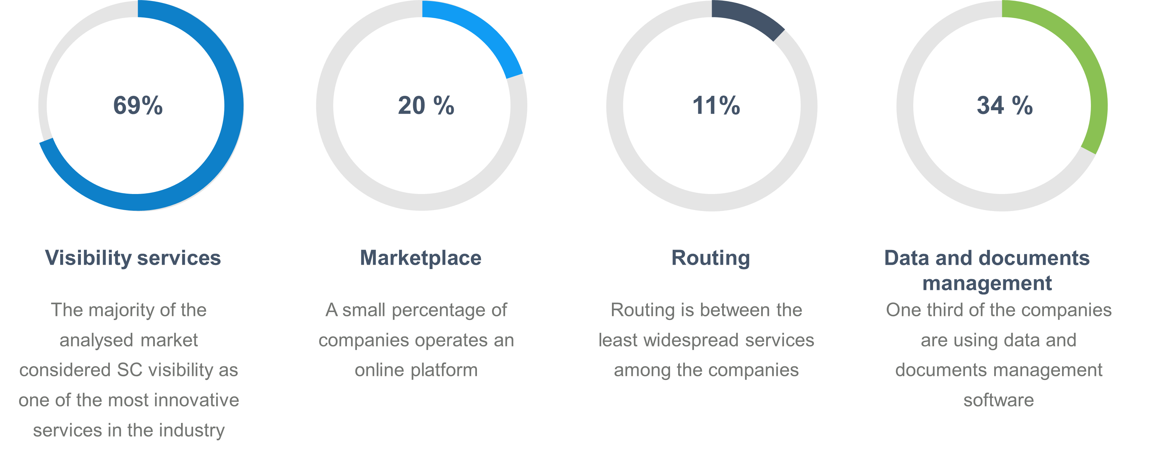
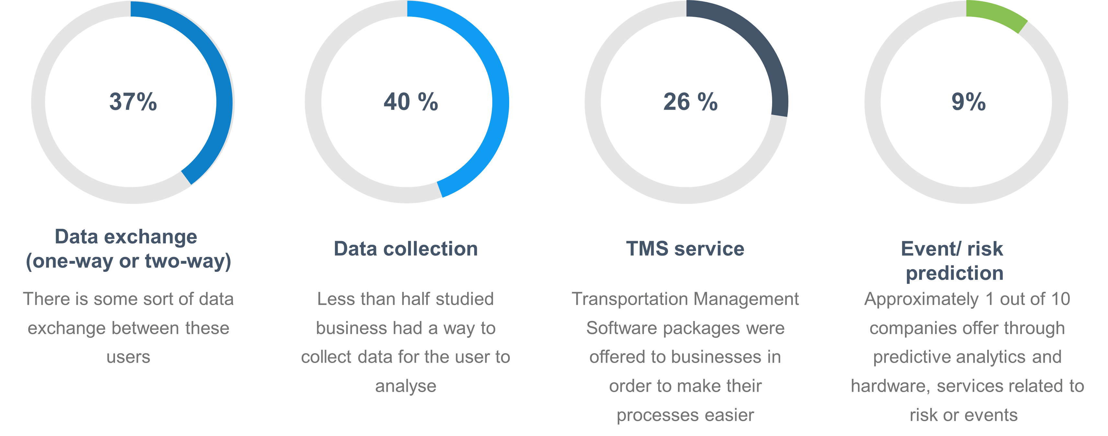
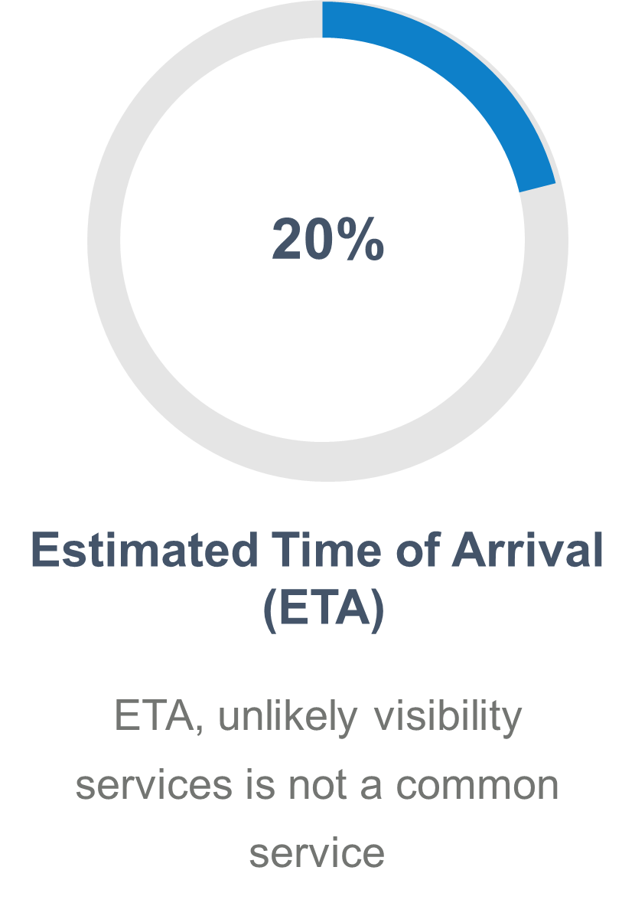
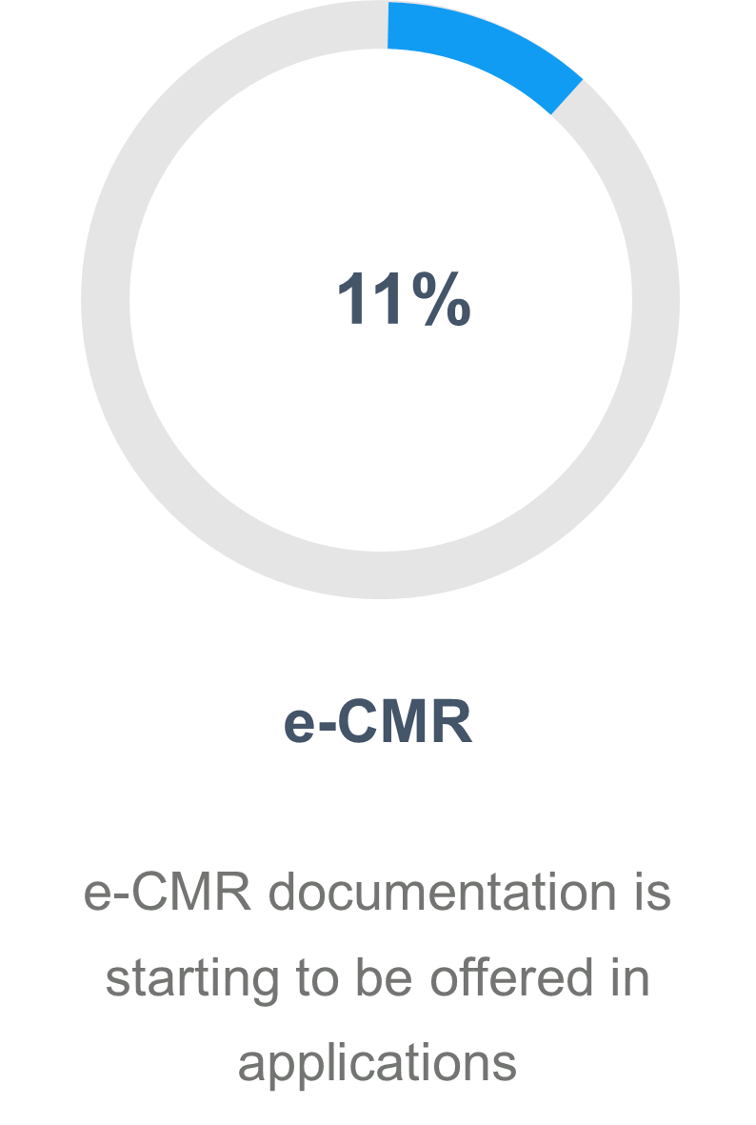
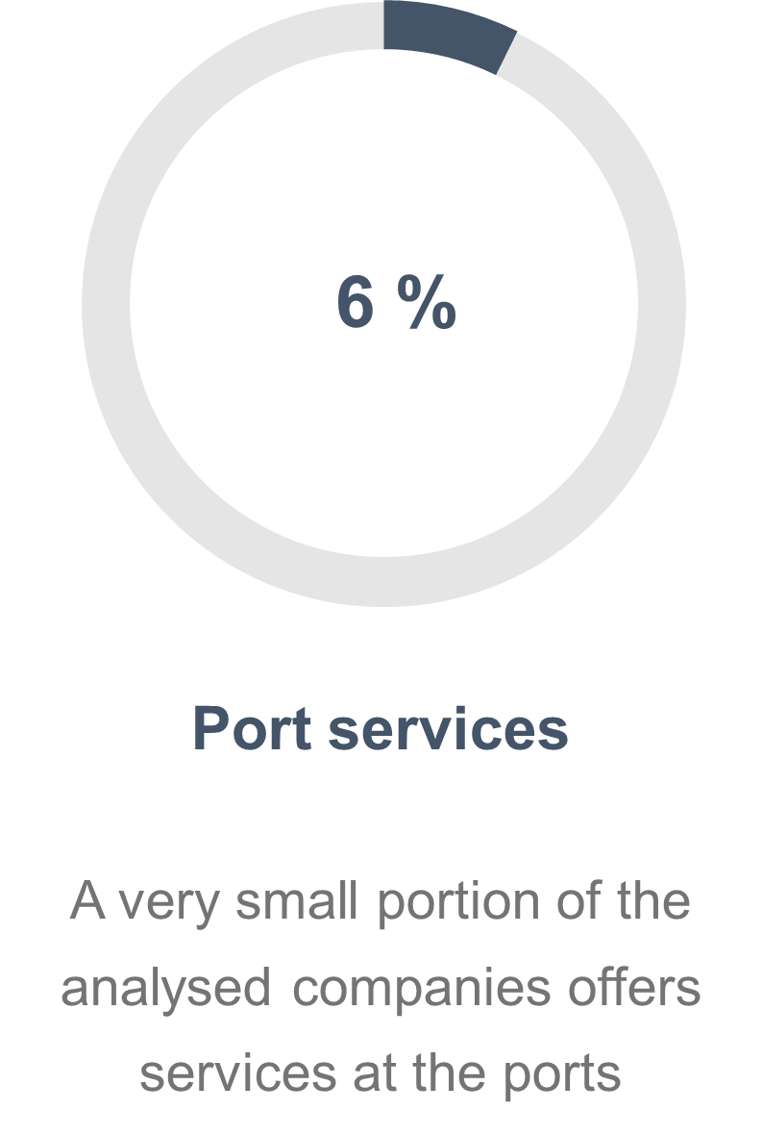
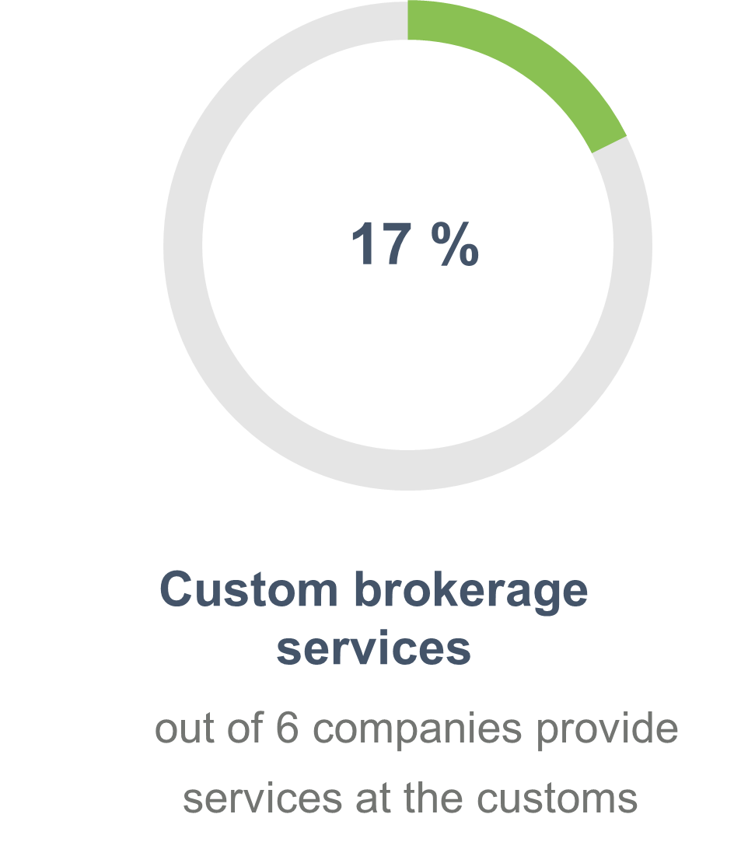
Consolidation and fragmentation in the logistics industry– The 45+ analysis

Slide 6
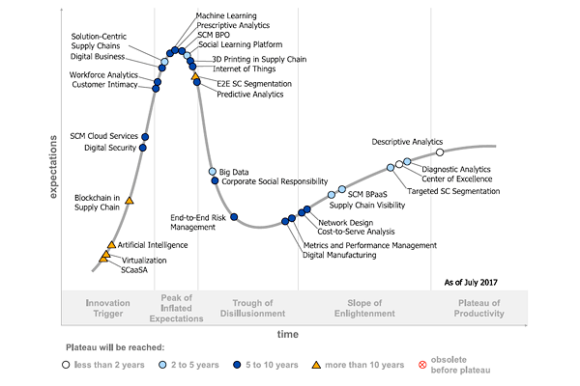
What is shaping the future of global logistics markets?
Supply chain visibility will soon be standard business practice (2-5 years)
AI and Block chain (10+ years)
Notes:
Thirdly, what are your bets on the emerging trends that will impact the future of supply chains? Well the famous Gartner said go for the quick wins in the end 2-5 years that is on end to end visibility of the supply chain and leave block chain and other to mature another 10 years.

Slide 7
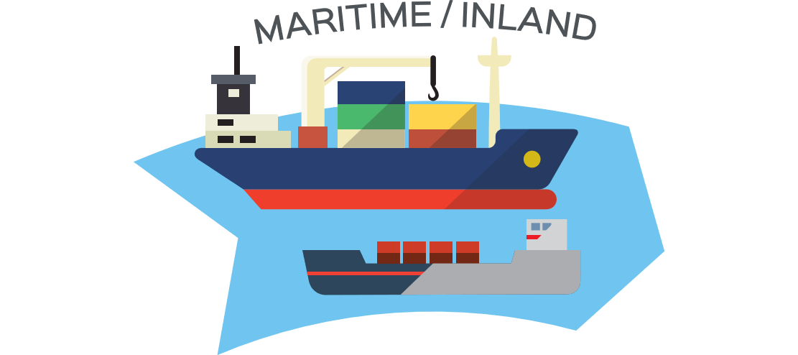
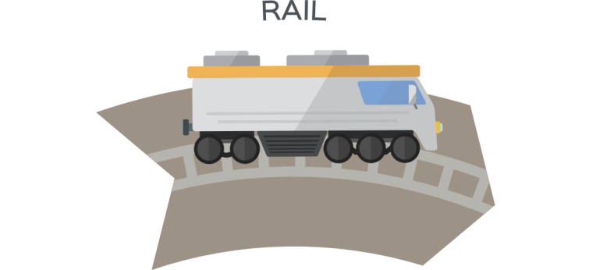
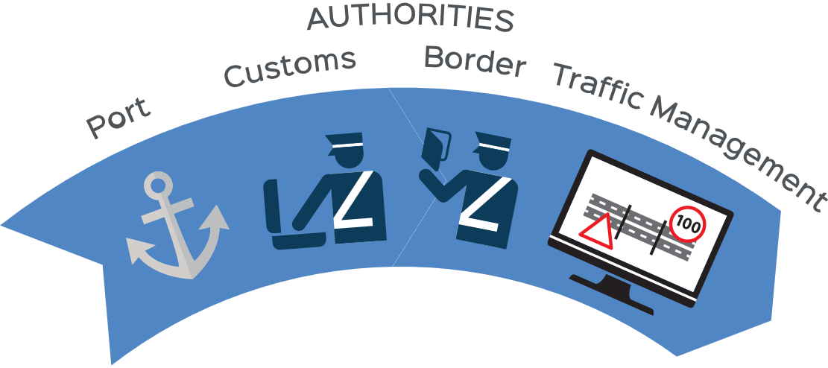


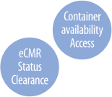
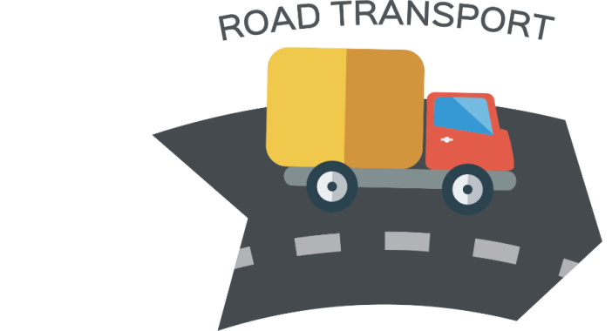



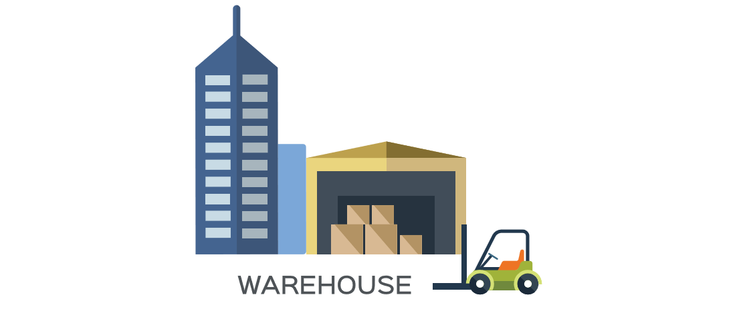



Slide 8
We need a ‘’’Trusted data network’’
Data push model
Model enables real time information to interested parties ensuring automated logistics processes in the logistics stakeholders apps / systems
Open
Each owner of the data pipeline decides who can participate and how (producing data, reading…)
Data from legacy systems
Data easy to use and consume for legacy systems exposing AEOLIX core services as API / Rest services
Data Privacy assurance, authentication and security mechanisms
Data Privacy assurance, authentication and security mechanisms
Data architecture
Built upon existing recognised industry and European standards and has proven reference data implementations
Visible and recognised as a trust Label within industry and public authorities.
Validated through compliance testing and certification
Data is not stored in any central database but is produced and maintained in original data format by its owner

Slide 9
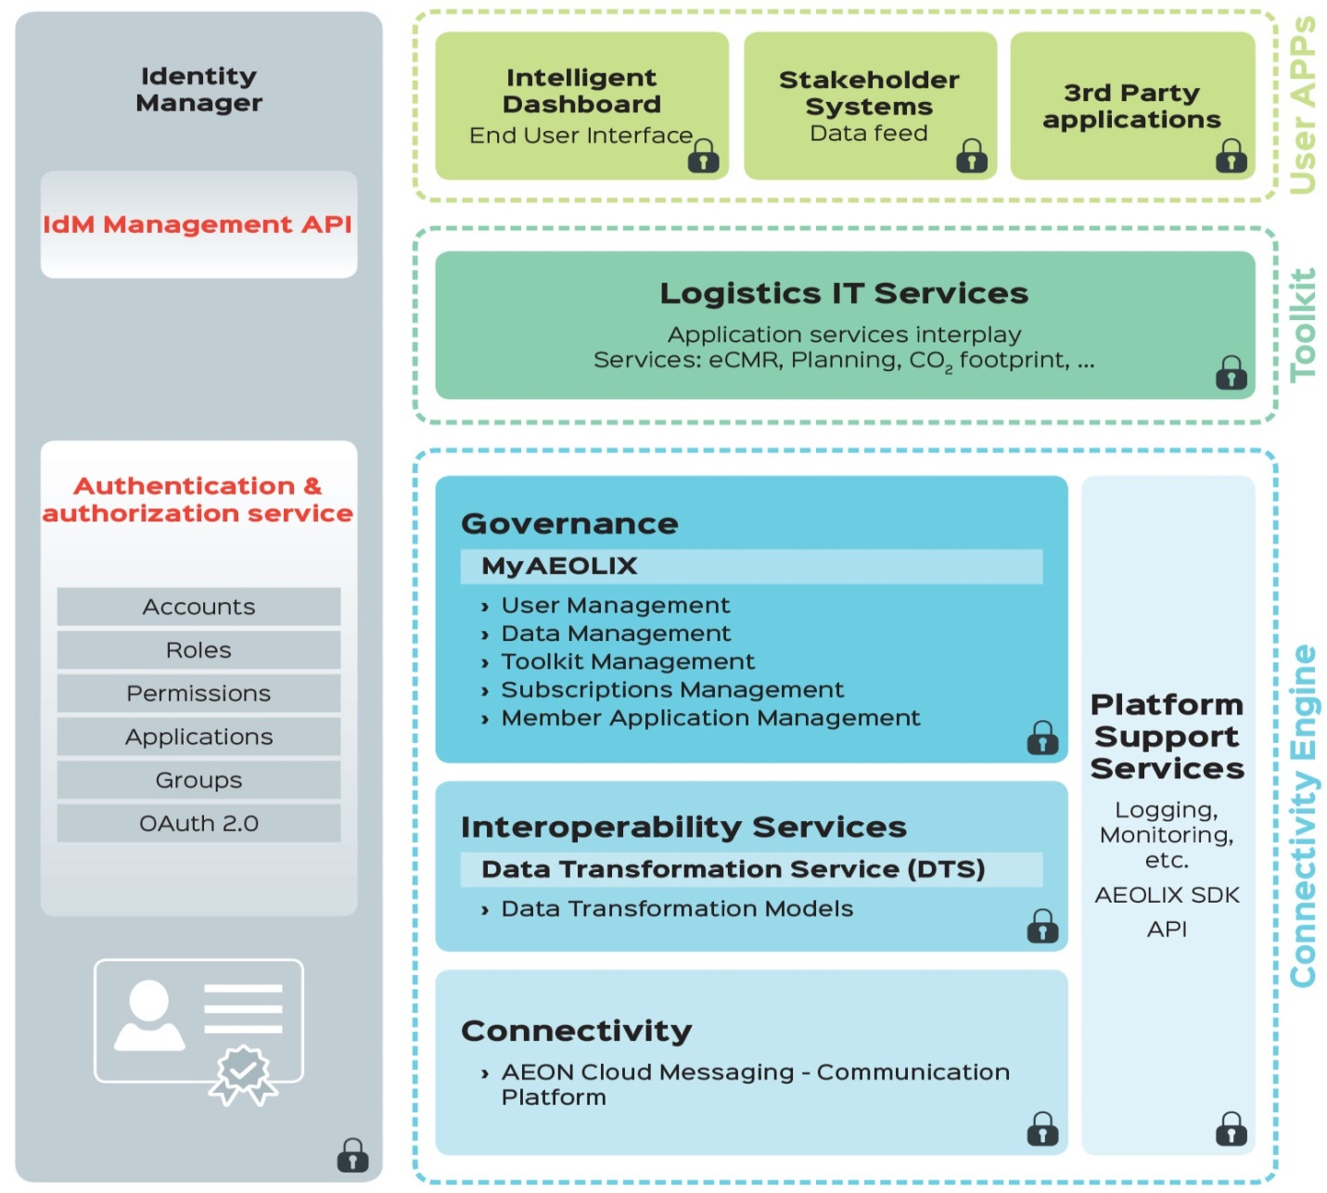
AEOLIX end to end visibility network
AEOLIX network
  cloud-based
  multi-enterprise
  “many-to-many”
Captures and streams data real-time
Automatically translates “data format” from different IT systems
Giving organisations the ability to rapidly respond to issues through a customised dashboard.

Slide 10
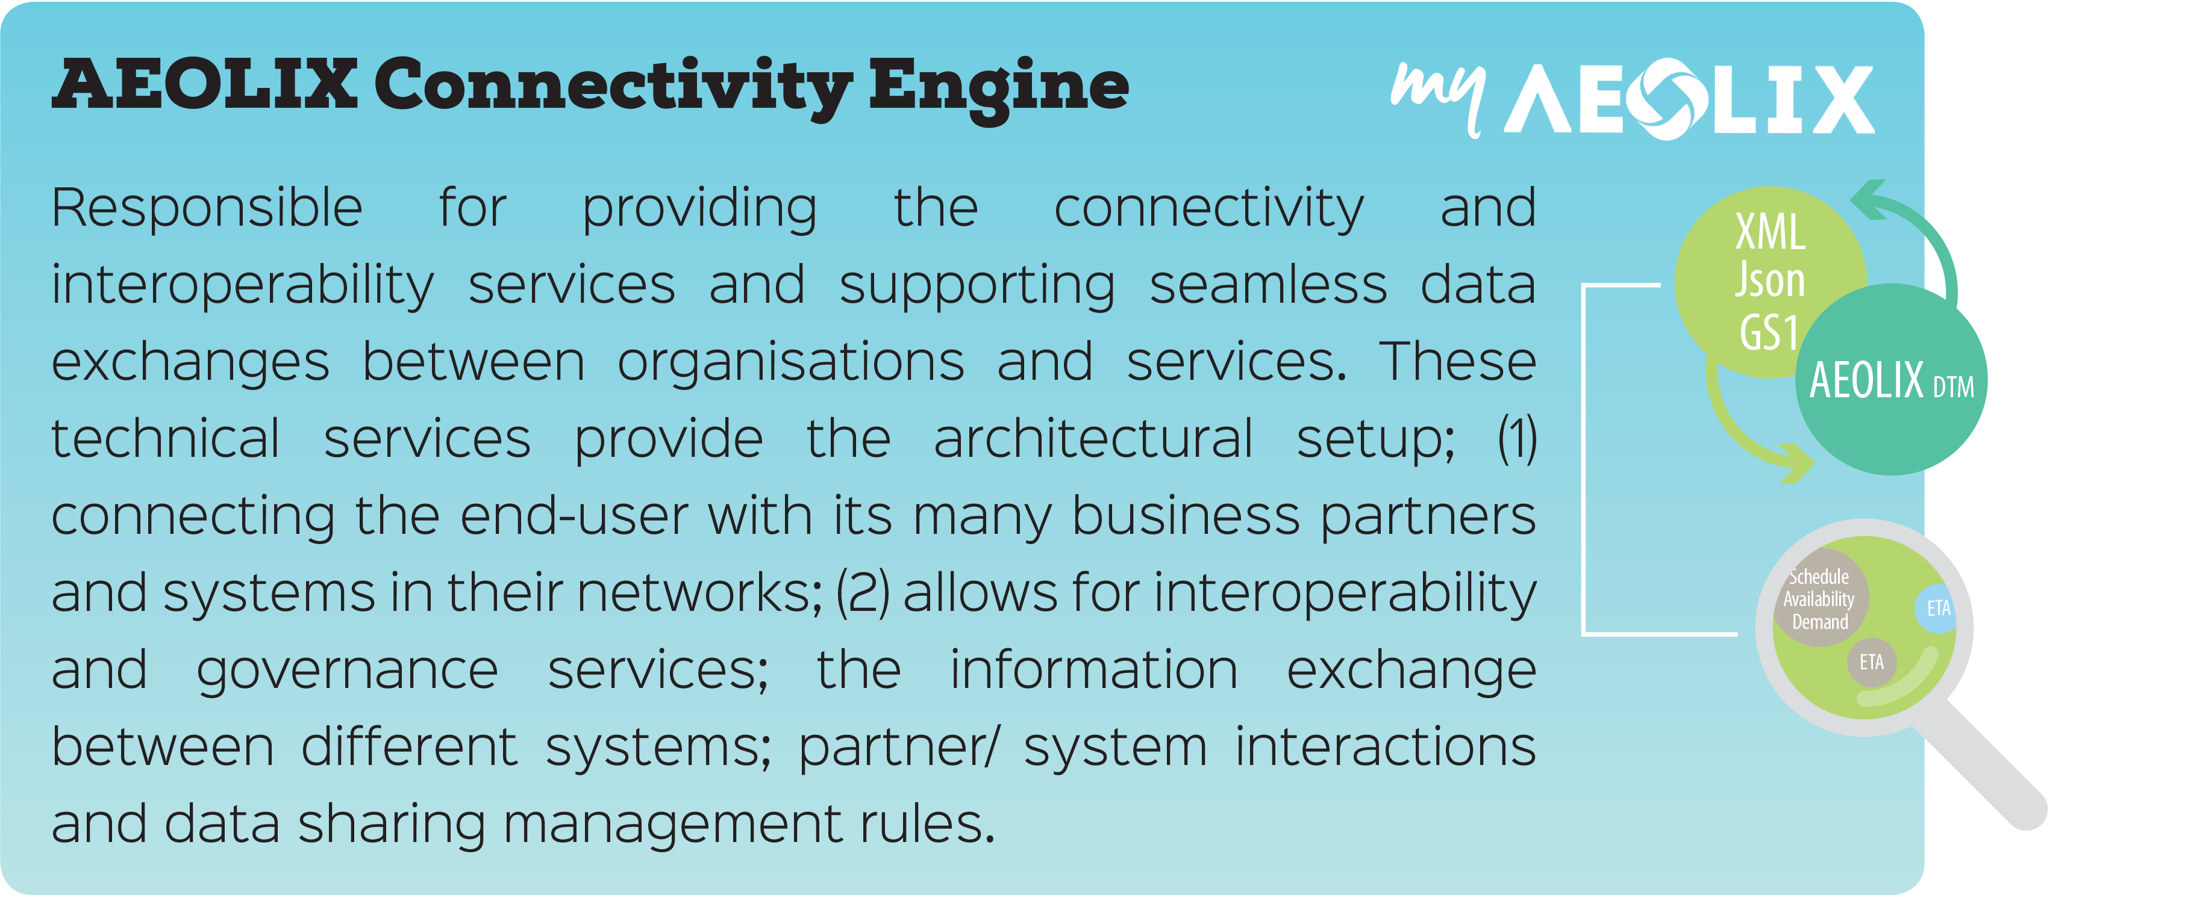

Slide 11
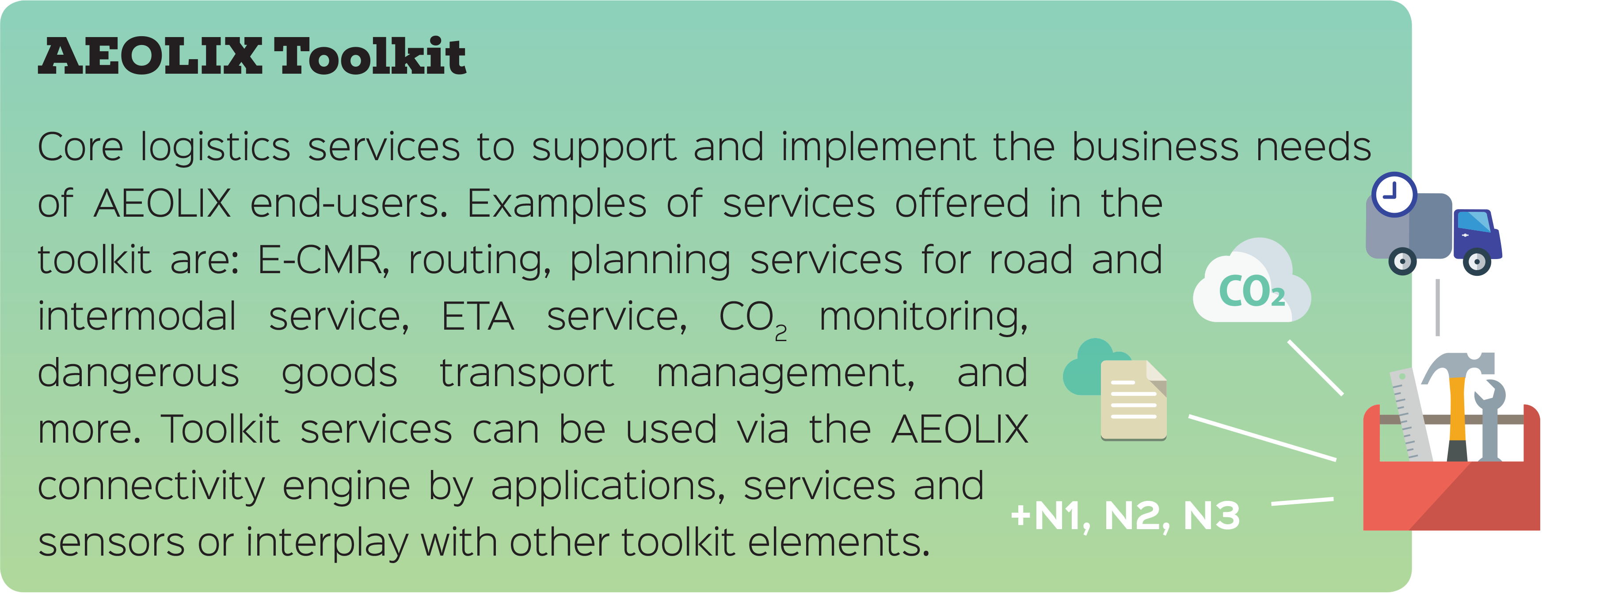

Slide 12
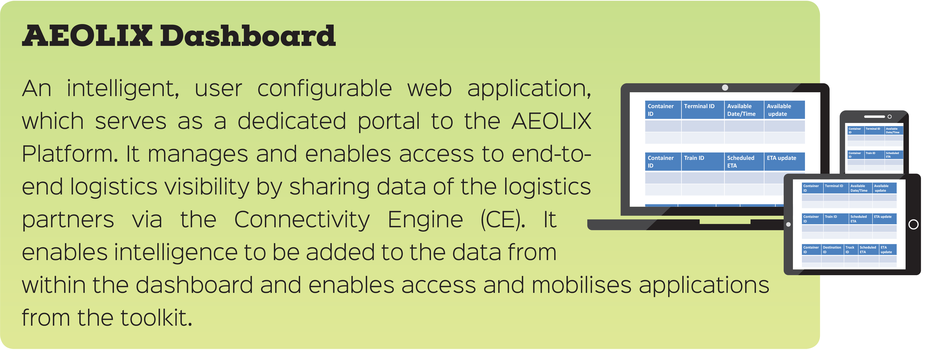

Slide 13
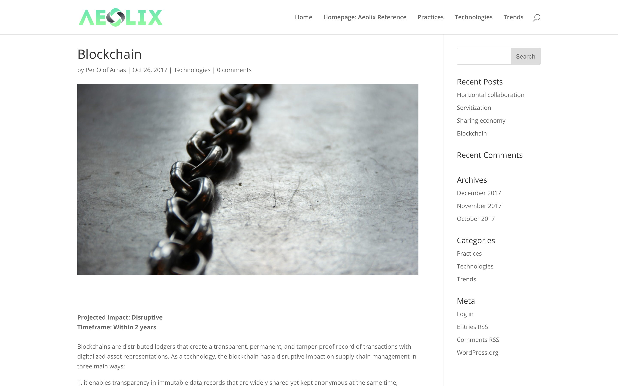
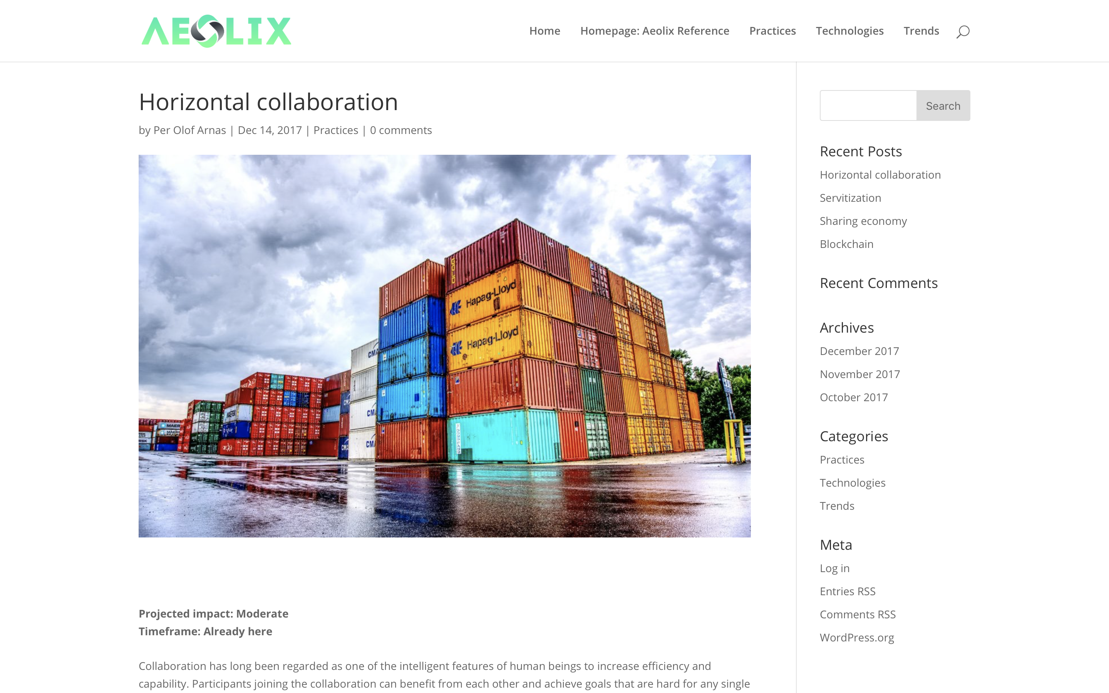
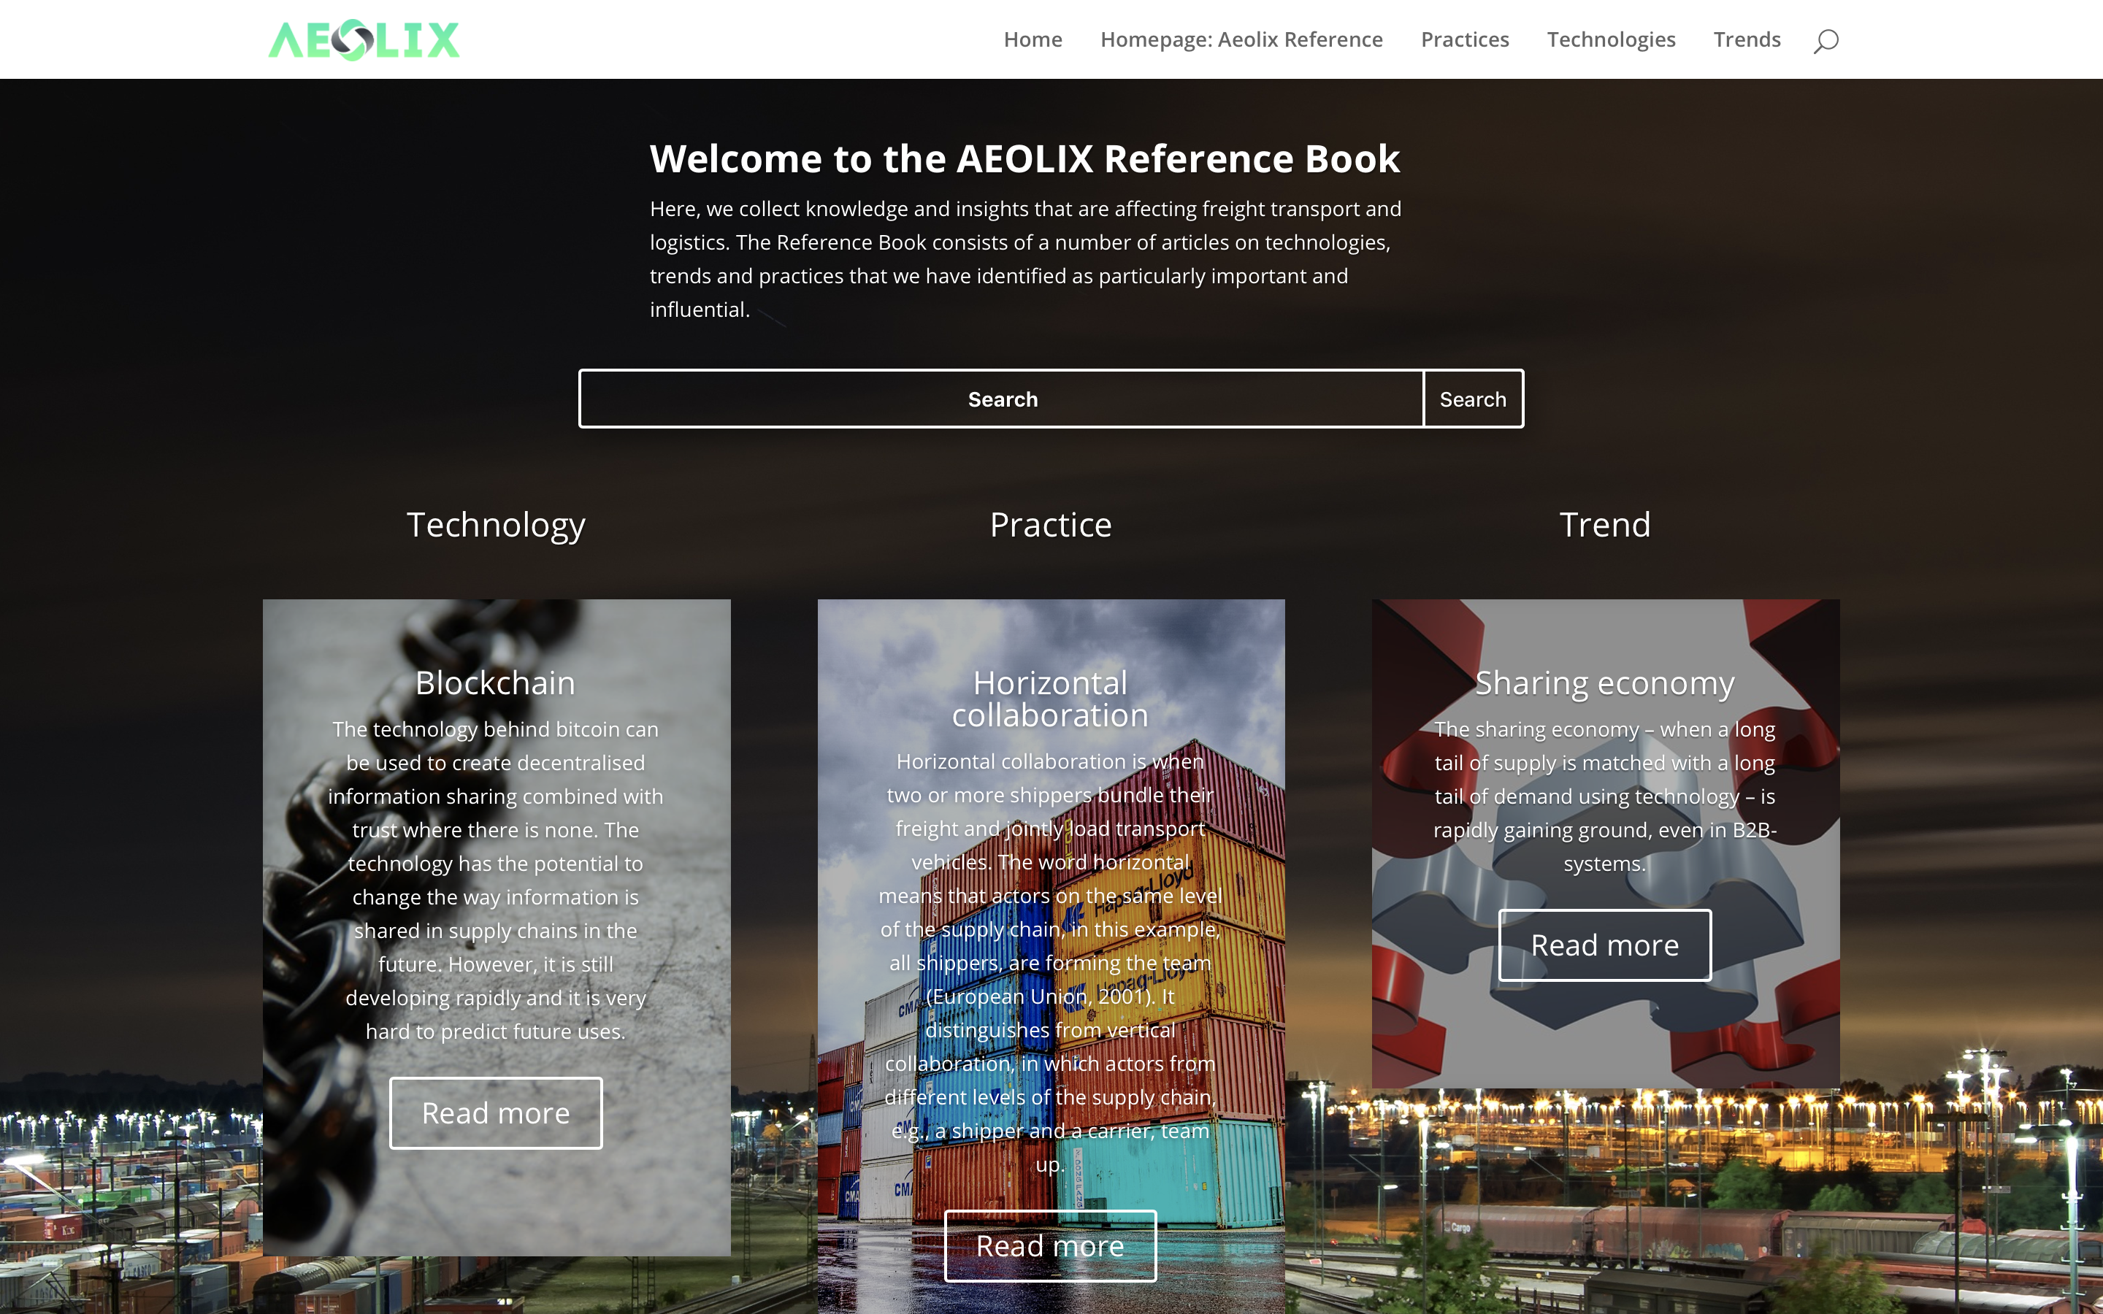
Monitoring & technological trends scouting
reference.aeolix.eu

Slide 14
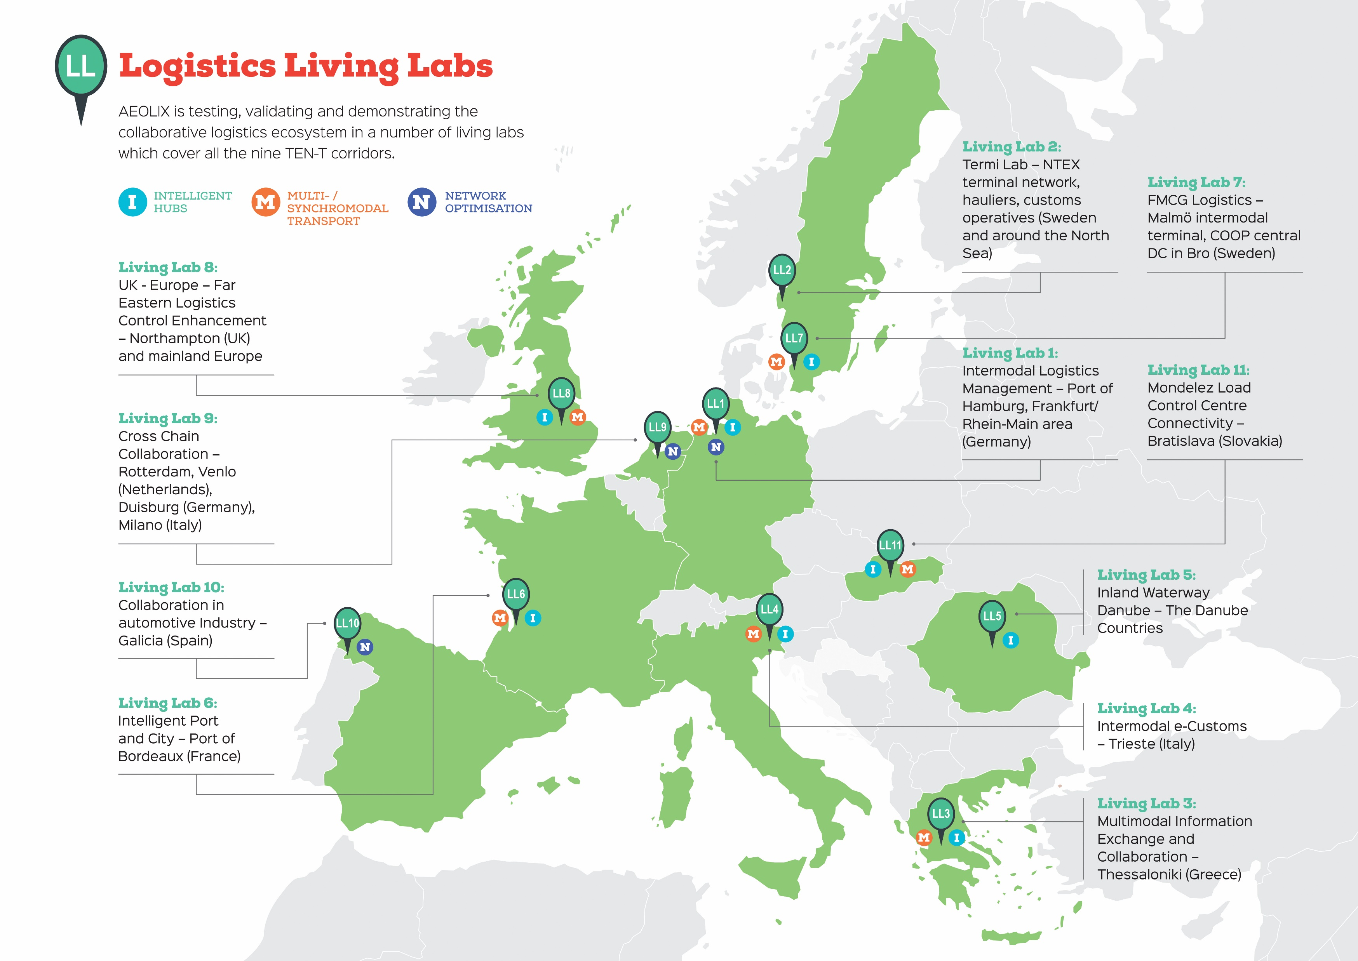

Slide 15
Important milestone – Launch of new Living Lab 12
Living Lab 12: Digitalization of freight transport documents
Consortium Partners
  IRU projects (Leader)
  • Bundesverband Güterkraftverkehr Logistik und Entsorgung e.V. (BGL)
  • Hellenic Federation of Road Transports (OFAE)
  • Association of Road Transport Operators CESMAD BOHEMIA (CESMAD)
  • Chamber of Commerce and Industry of Serbia (CCIS)
  • Greek Ministry of Infrastructure and Transport (MIT)
  • Uniunea Nationala A Transportatorilor Rutieri Din Romania (UNTRR)
Objectives
    Testing e-CMR service
    Usage of digital freight transport documents at cross-border level in Europe
    Improve the efficiency, reliability and cost-effectiveness of freight transport operations

Slide 16
Thessaloniki Logistics Living Lab
Partners – 1st Generation Community
  CERTH / HIT (Leader)
  Greek International Business Association (SEVE)
  Hellenic Federation of Road Transports (OFAE)
  Thessaloniki Chamber of Commerce and Industry (TCCI)
  Transeuropean Consultants for Transport, Development and Information Technology - TREDIT S.A.
2nd Generation Community
    Expanded to the members of TCCI (15 members confirmed i.e. Delta 4, MAKIOS SA,NITROFARM SA)
    Expanded to the members of OFAE (9 members - truck drivers & companies )
    Expanded to the members of SEVE (6 members -Exporters to Balkan and North-East Europe)

Slide 17
Thessaloniki Logistics Living Lab
Two different scenarios
  Virtual Freight Center (VFC)
  Cargo bundling marketplace and monitoring
Virtual Freight Center
  Support companies that facing difficulties providing warehousing facilities due to the variable demand.
  AEOLIX will support to the information exchange between the relevant actors though demand-supply matching, booking management and warehousing analytics.
Cargo bundling marketplace and monitoring
  Support road transport operators to better utilize their transport capacities by avoiding empty or half-empty journeys.
  AEOLIX will improve the visibility among the logistics service providers and will allow them to utilise innovative logistics services.

Slide 18
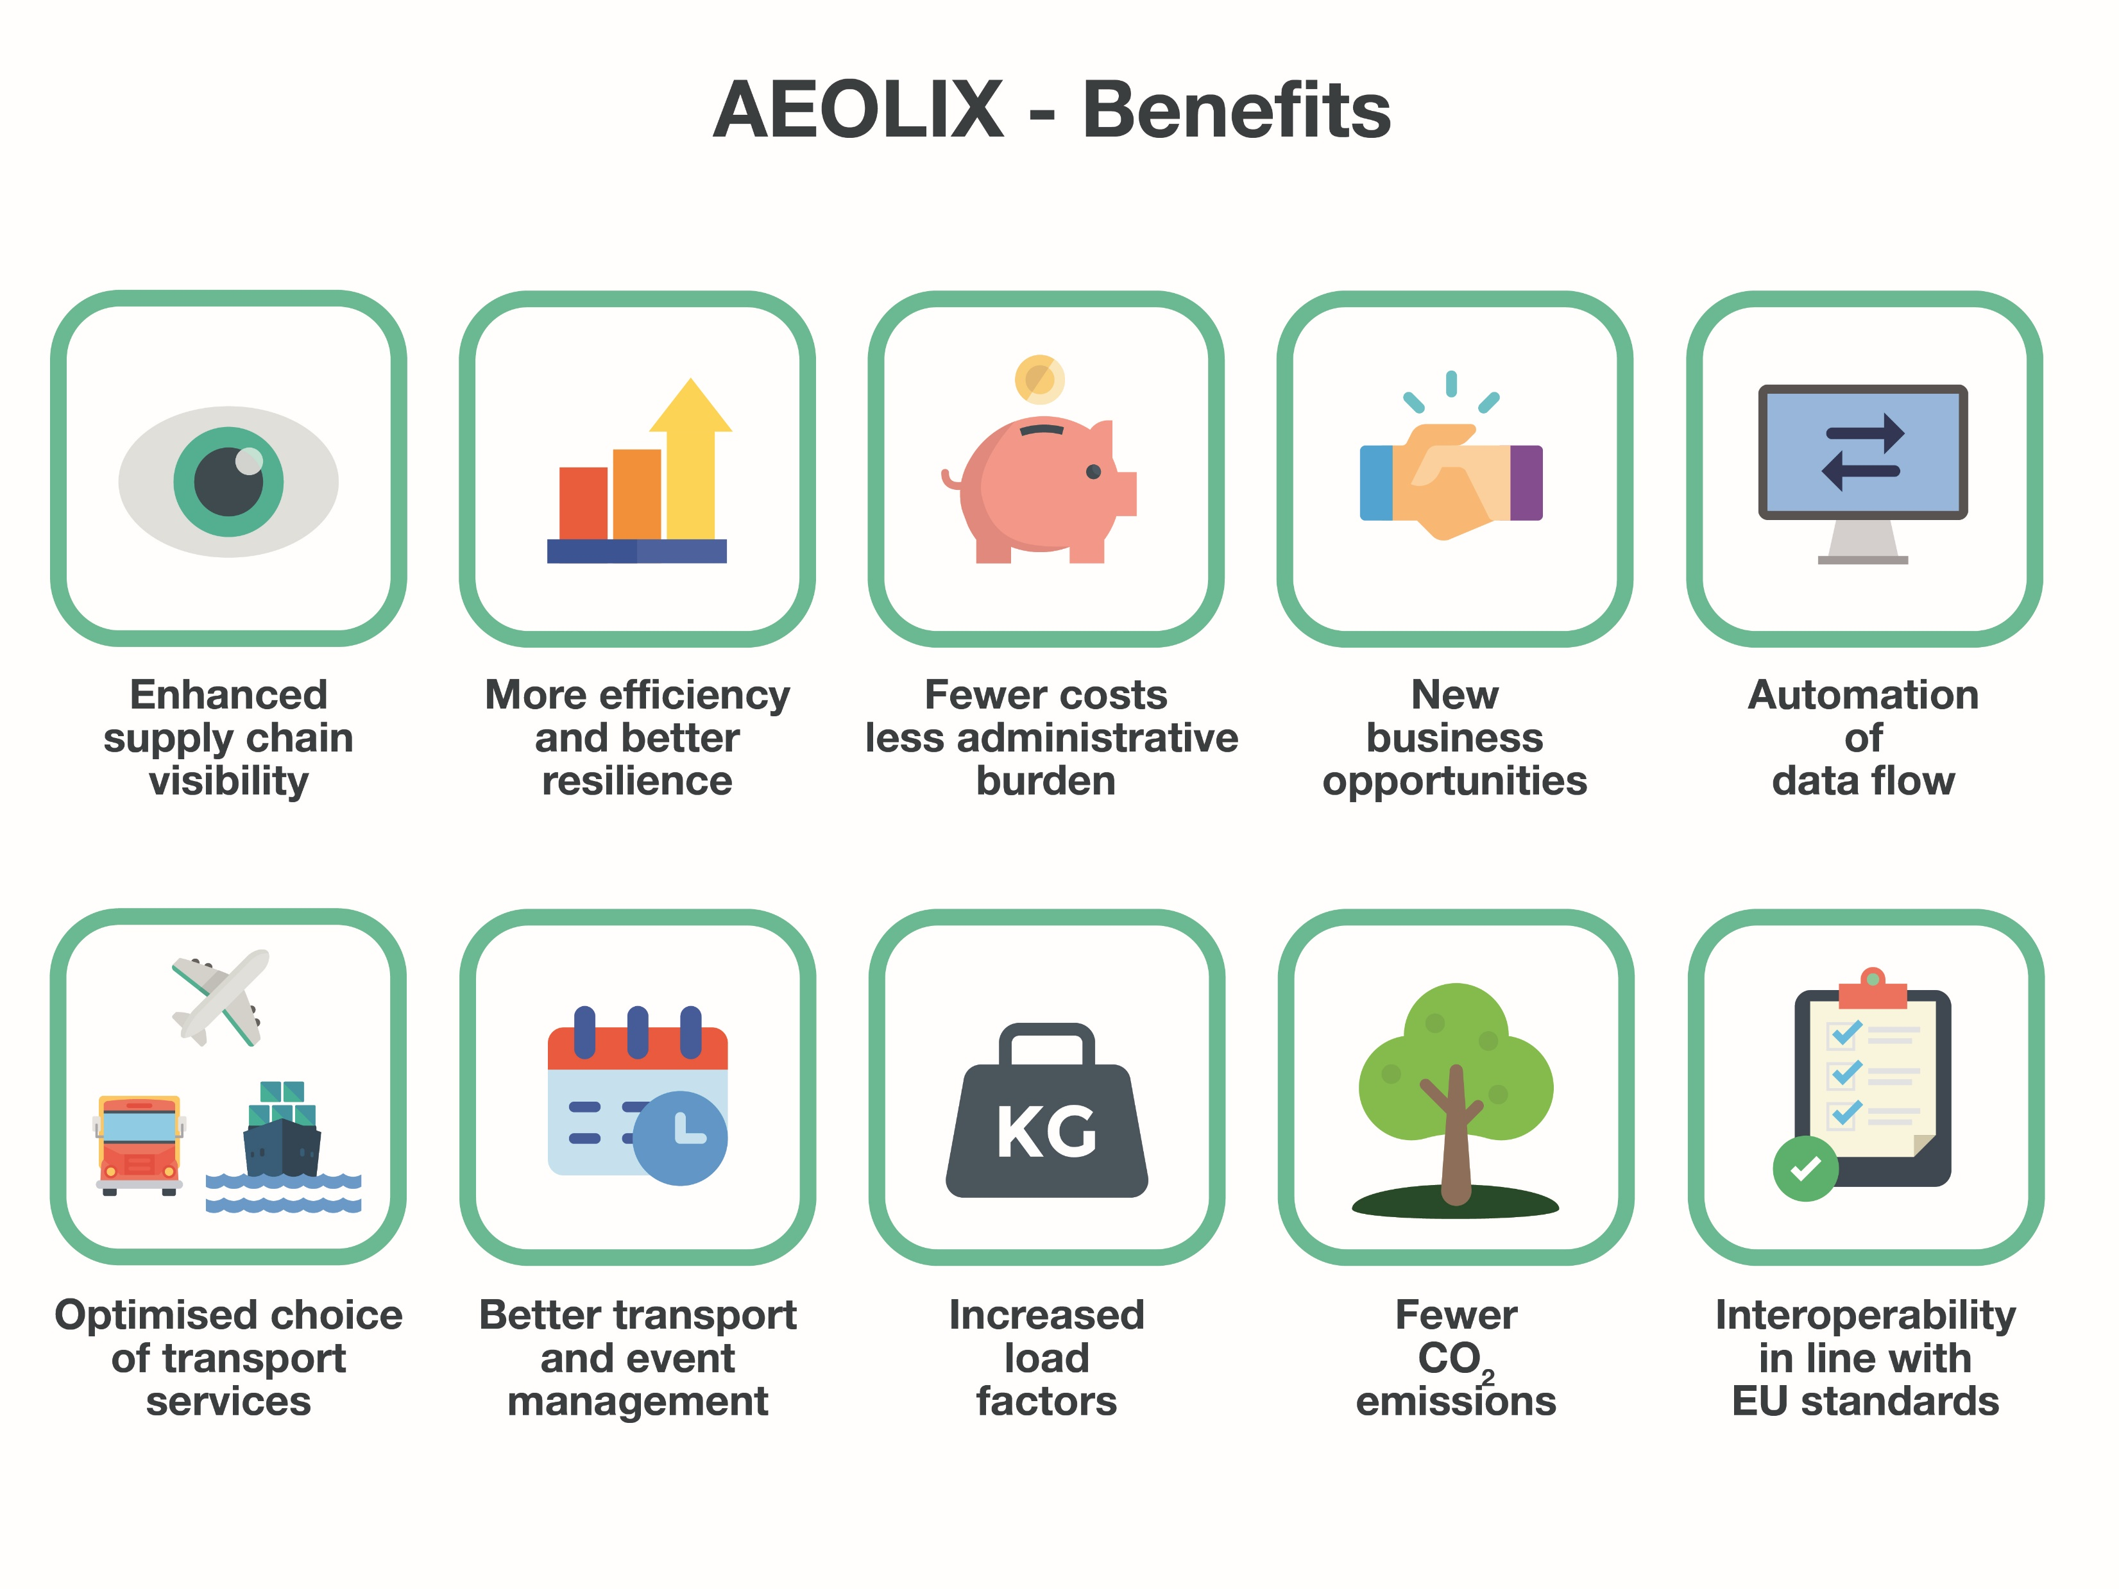
AEOLIX Benefits

Slide 19
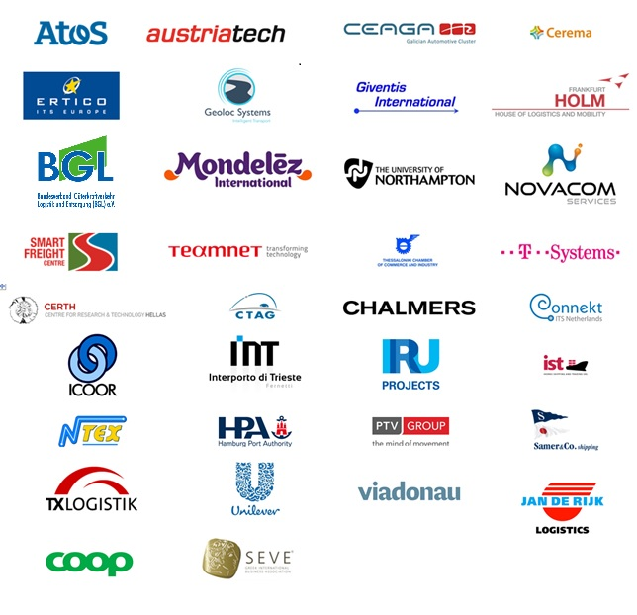
AEOLIX partnership

Slide 20
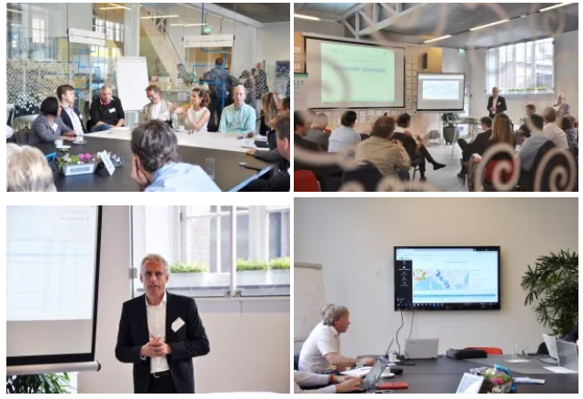
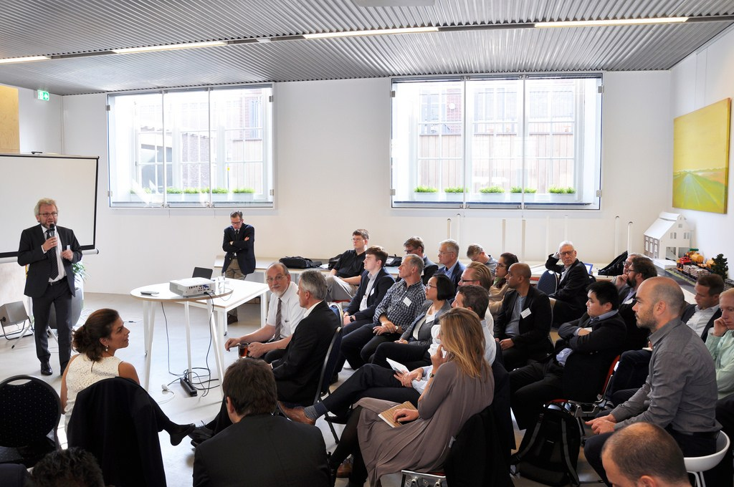
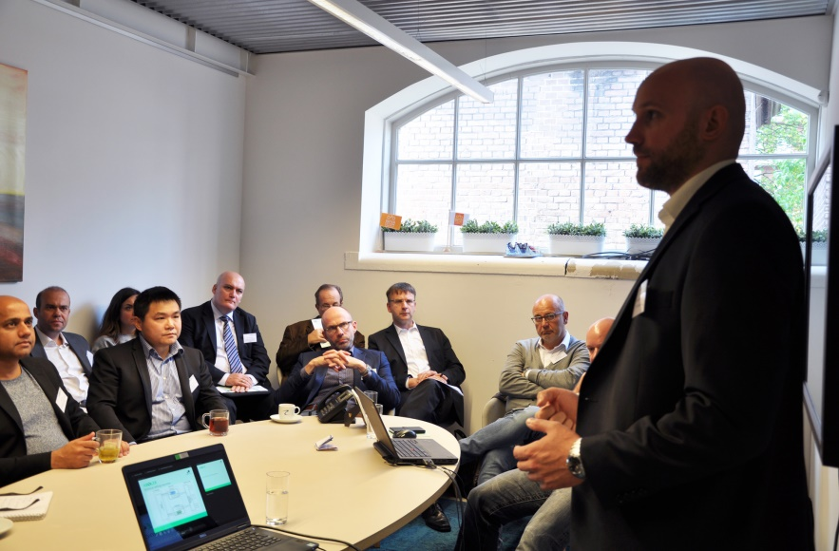
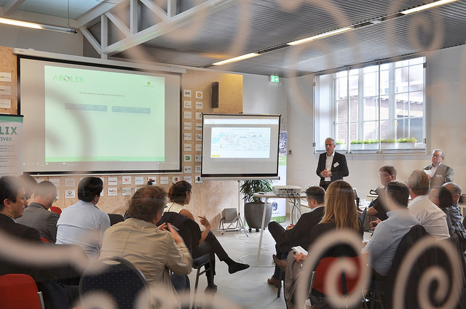
Get engaged to AEOLIX network events
Notes:
Stakeholders enlargement expected involving more consignees & LSPs but also other actors such as Port of Thessaloniki, Railway operators, IT providers for WMS & Fleet management
Testfest open to stakeholders will organized in Thessaloniki

Slide 21
Thank you !!
Dr. Georgia Aifadopoulou: [e] gea@certh.gr, [t] +302310498457

